Slide 1
GHANA CALIBRATION
90 m

Slide 2
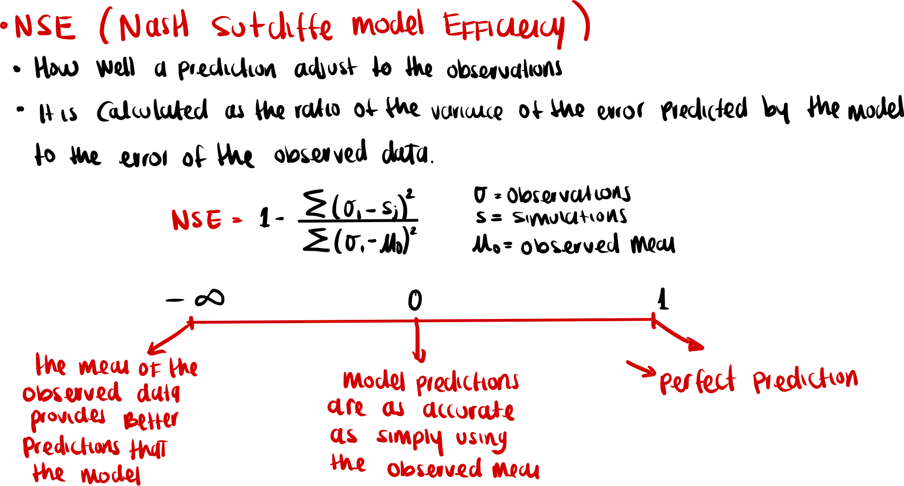
Notes:
Source trail

Slide 3
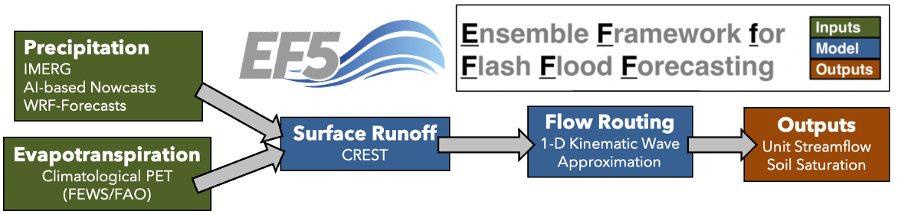
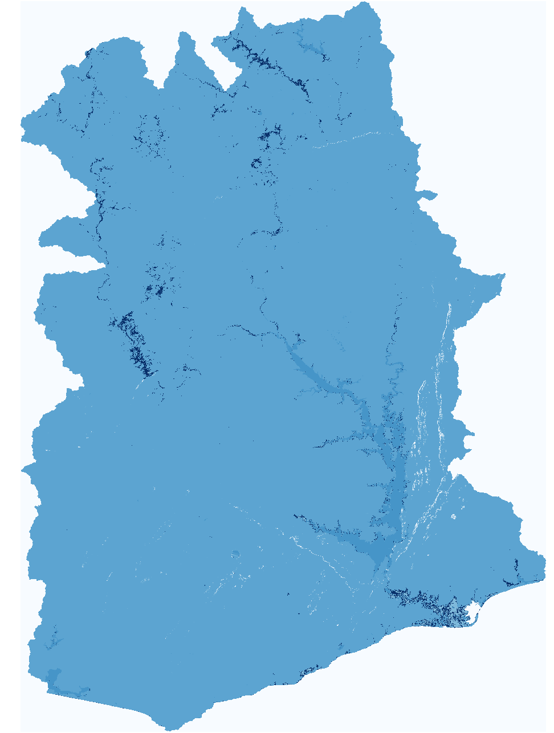
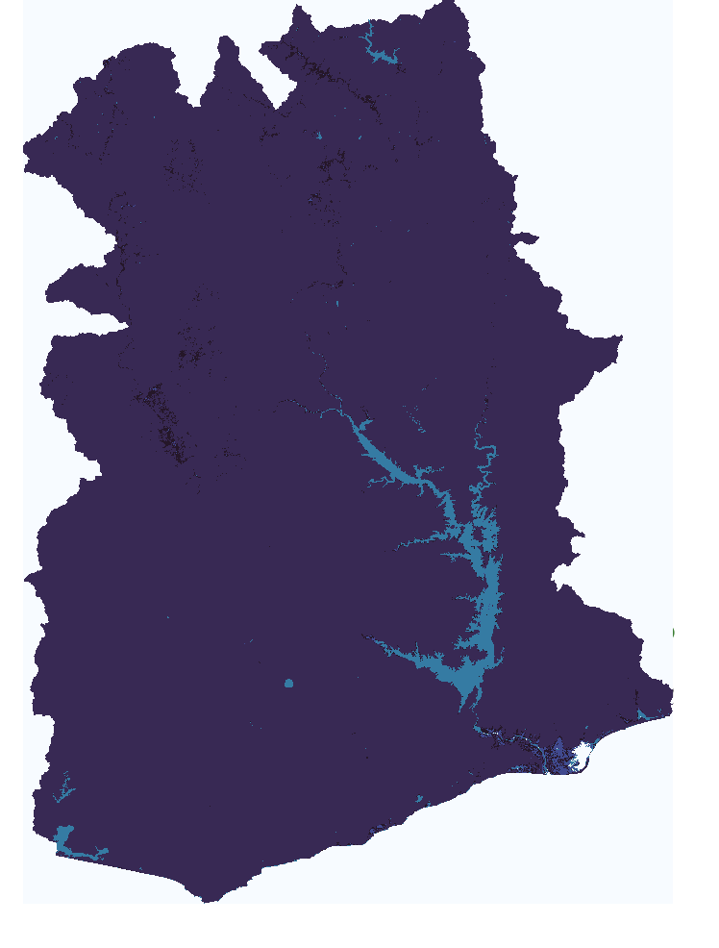
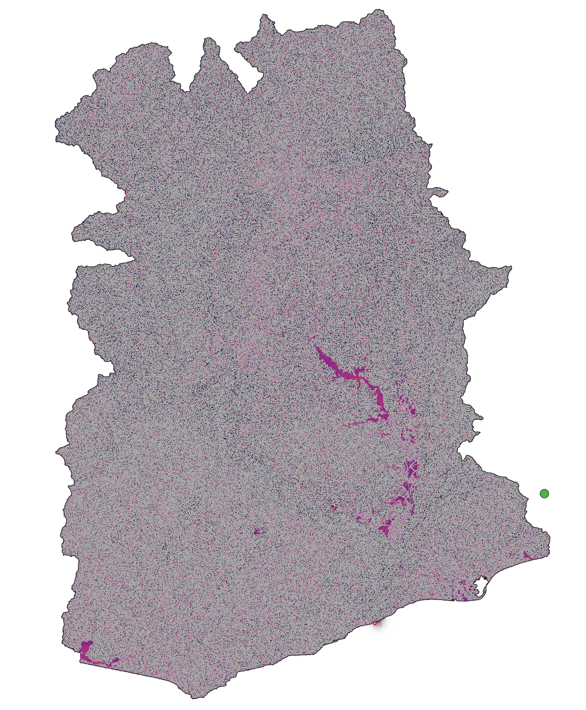
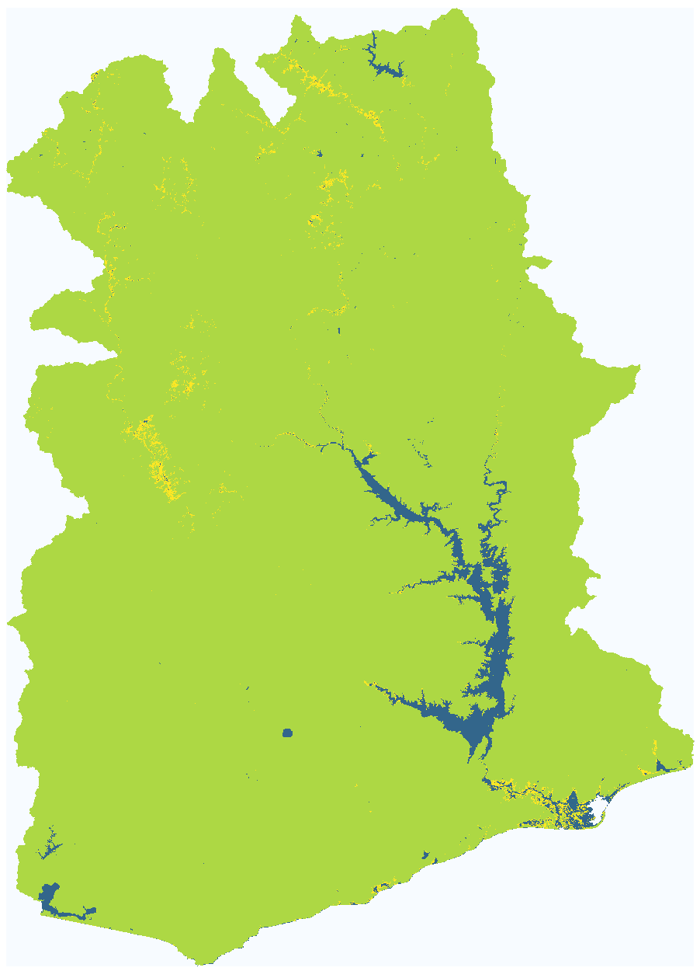
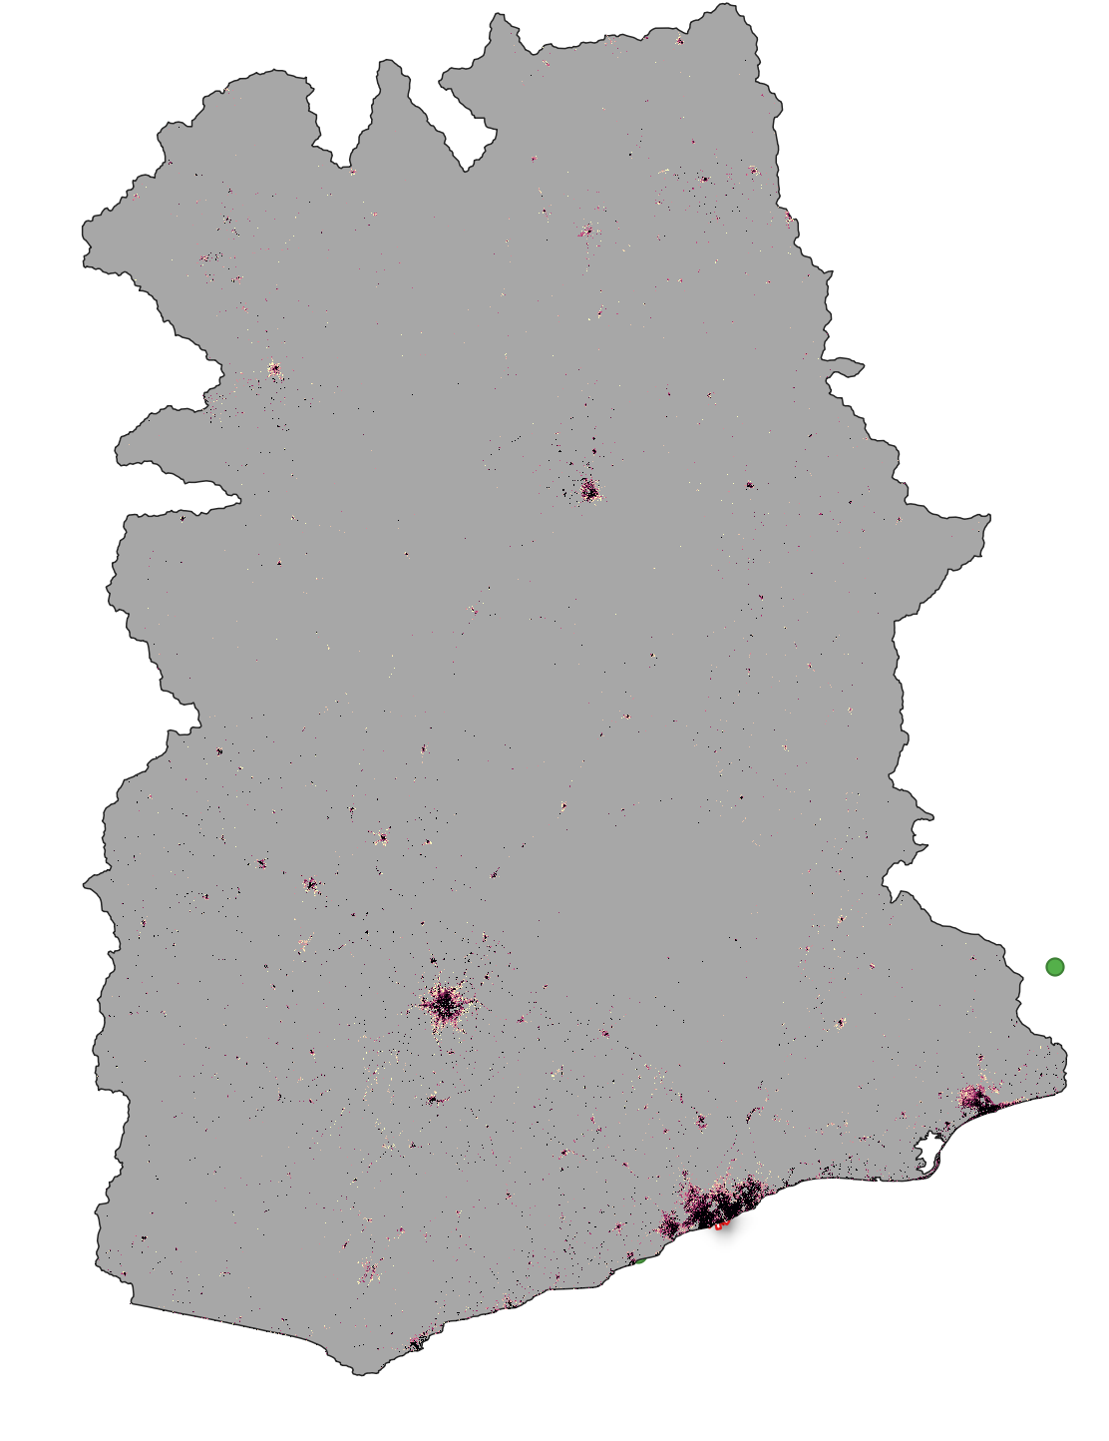
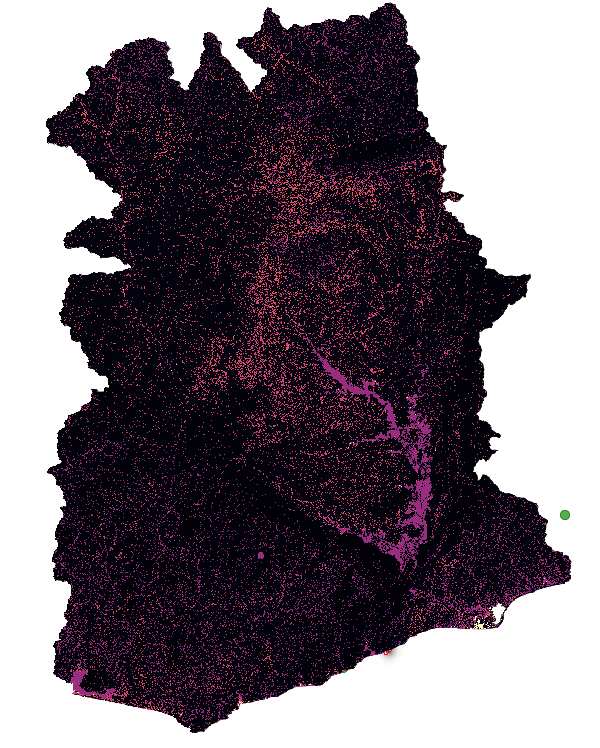
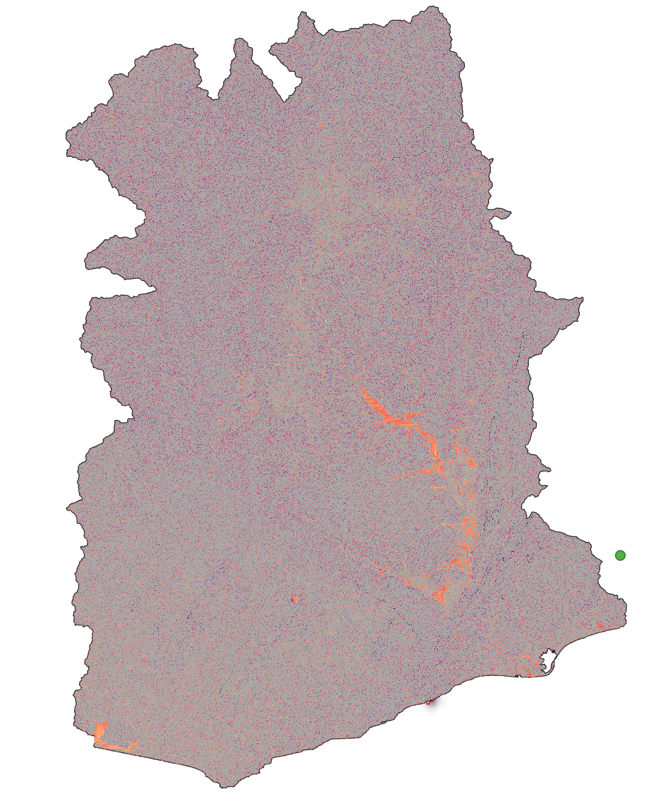
Ghana90m Baseline
wm
ksat
alpha
b
im
alpha0
beta

Slide 4
Manual pixel correction was performed for all stations (for both models 1 km and 90m).
Data analysis and cleaning was performed, obtaining the series with which we want to calibrate/validate both models.
Ghana 90m:
New impervious surface layer was processed (improving model performance).
Baseline for Ghana90m ready.

Slide 5
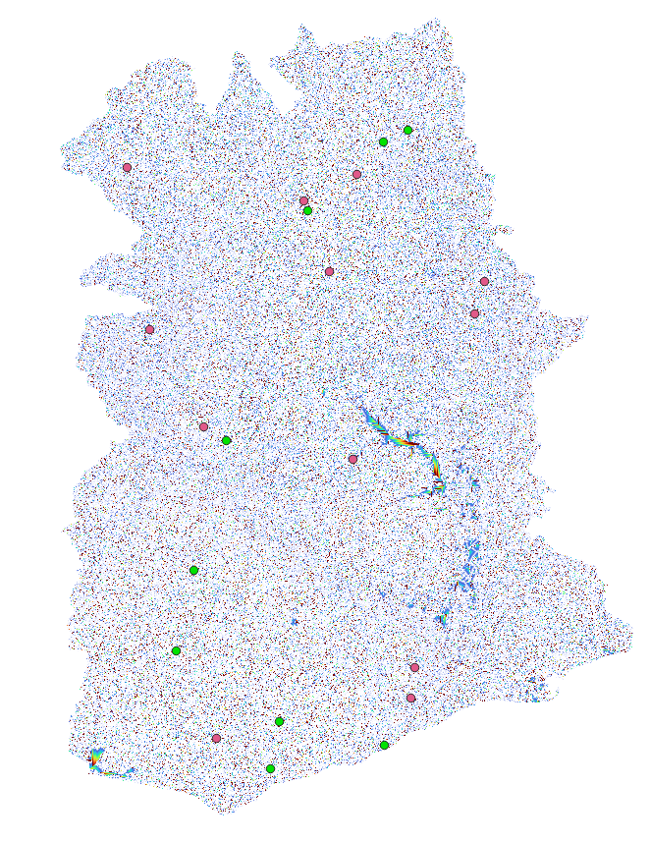
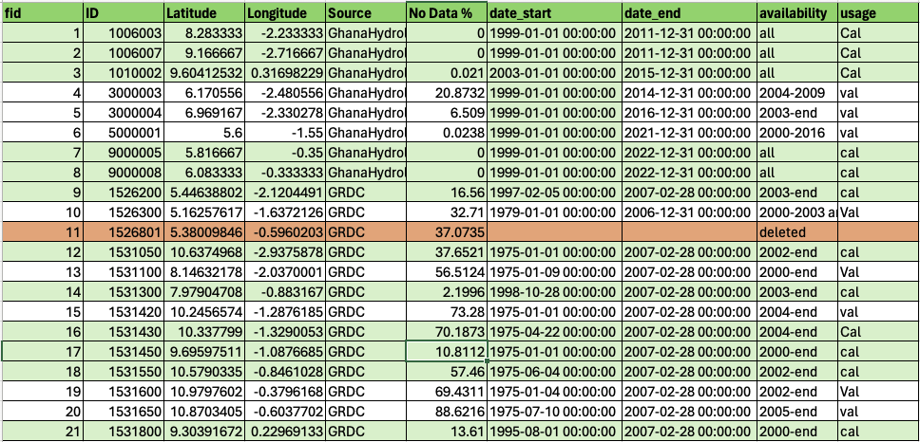
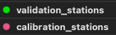
Gauge stations at 90m.
We currently have 21 stations.
We run with 20 stations:
12 for calibration, 8 for validation

Slide 6
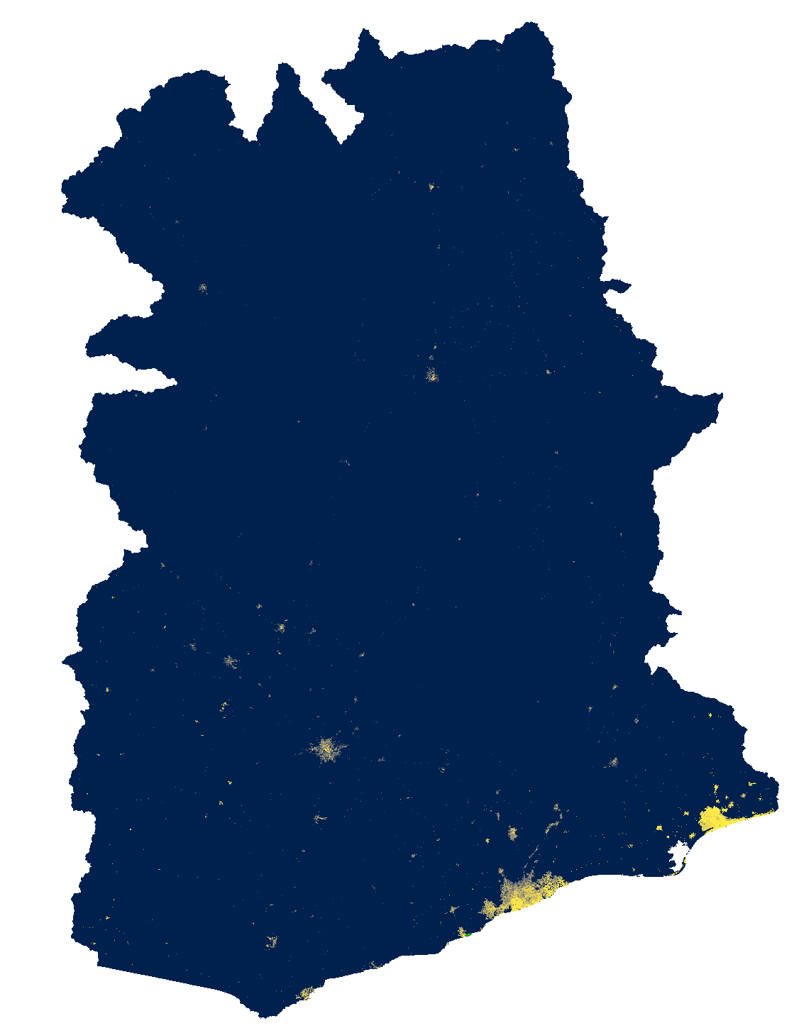
Global Man-made Impervious Surface (GMIS) Dataset From Landsat, v1 (2010)
Spatial resolution: 30m spatial resolution. The spatial extent covers the entire globe except Antarctica and some small islands. This dataset is the first global, 30m dataset of man-made impervious cover to be derived from the GLS data for 2010 and is a companion dataset to the Global Human Built-up And Settlement Extent (HBASE) dataset.
Data values: Percent imperviousness (0-100)
Limitations: The GMIS/HBASE datasets are derived directly from Landsat imagery from the Global Land Survey (GLS) 2010 dataset (Gutman et al. 2013). The quality of the GMIS/HBASE datasets is impacted by limitations of the selected GLS 2010 imagery and still contain residual cloud covered areas and areas where gaps caused by the Landsat 7 Scan Line Corrector (SLC) failure have not been successfully filled. The SLC gaps can cause visual features to appear in the data at different zoom levels. Areas where the gaps still persist or where cloud cover/cloud shadows were found have been coded as “NoData" (i.e. value = 255).
Processing: Data was processed by interpolation the NoData values.
Brown de Colstoun, E. C., C. Huang, P. Wang, J. C. Tilton, B. Tan, J. Phillips, S. Niemczura, P.-Y. Ling, and R. E. Wolfe. 2017. Global Man-made Impervious Surface (GMIS) Dataset From Landsat. Palisades, New York: NASA Socioeconomic Data and Applications Center (SEDAC).https://doi.org/10.7927/H4P55KKF.

Slide 7
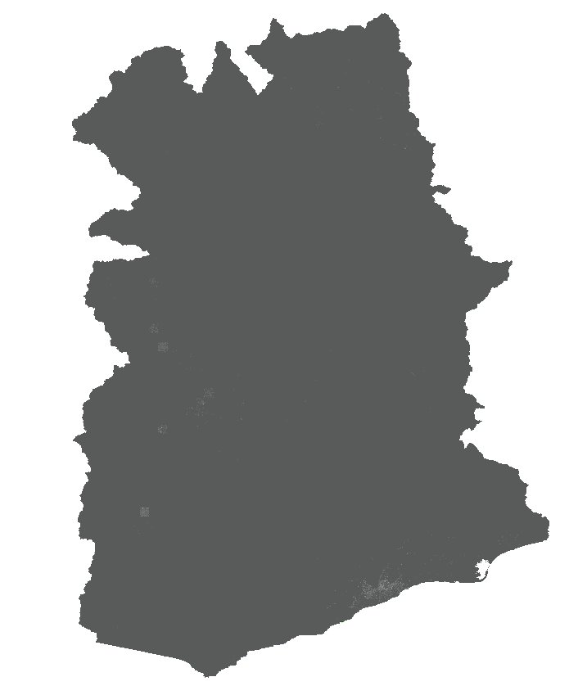
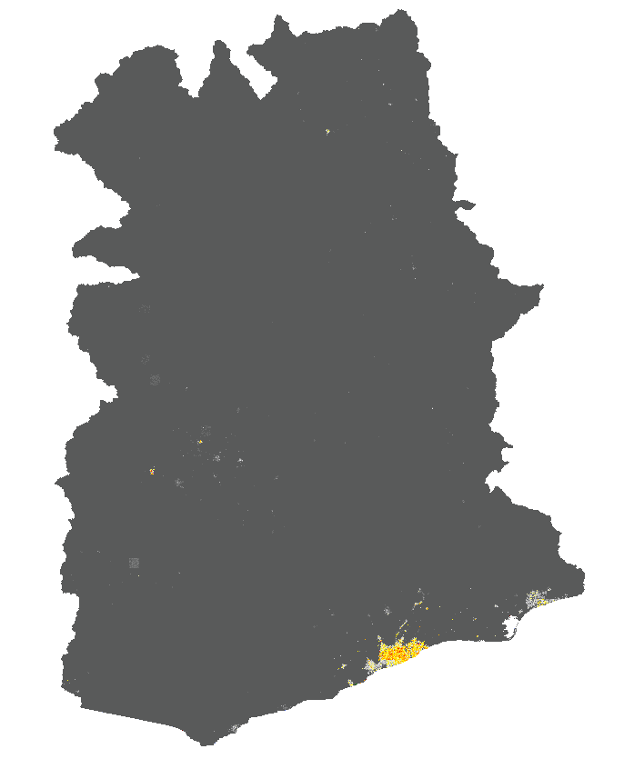
-No warmup
-New impervious surface layer
-No warmup
-Old impervious surface layer

Slide 8
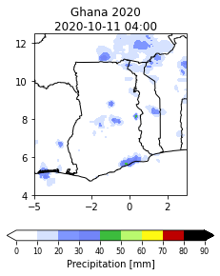
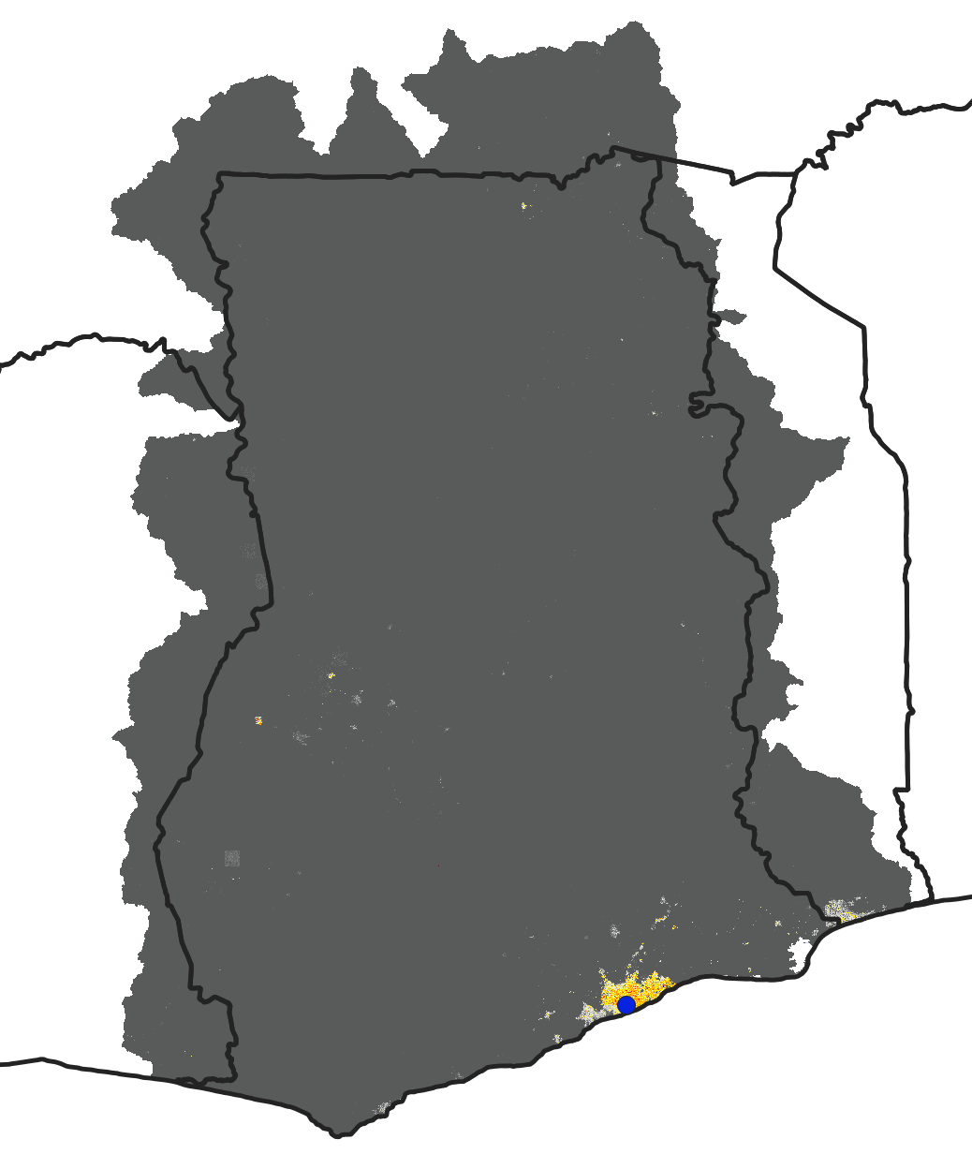
-No warmup
-Old impervious surface layer
-No warmup
-Old impervious surface layer

Slide 9
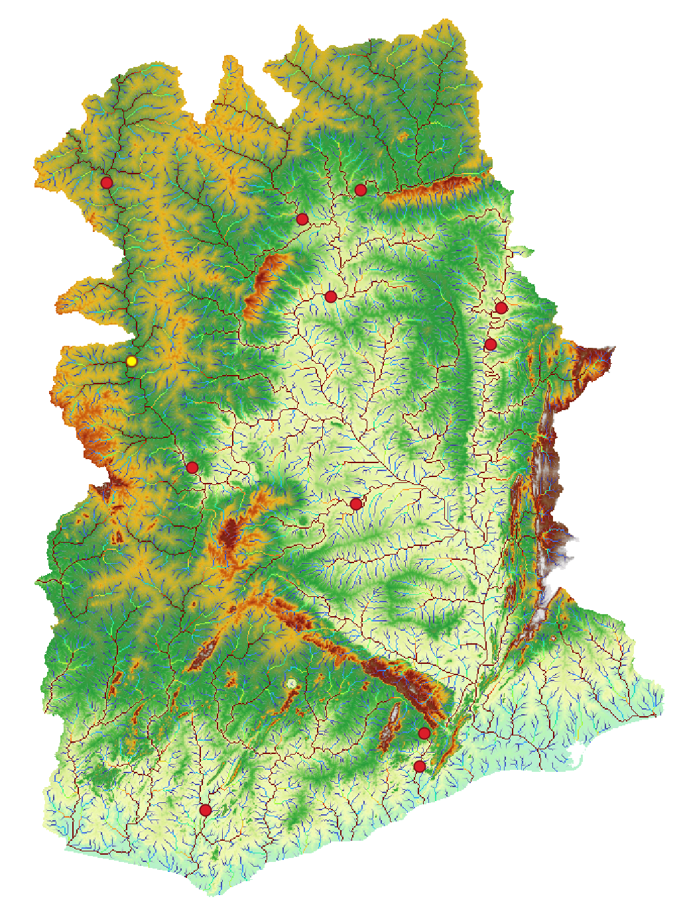
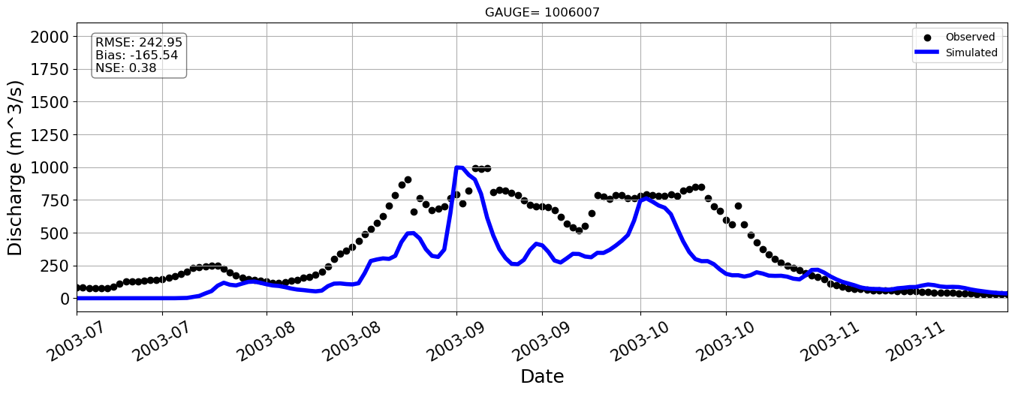
Station=1006007

Slide 10
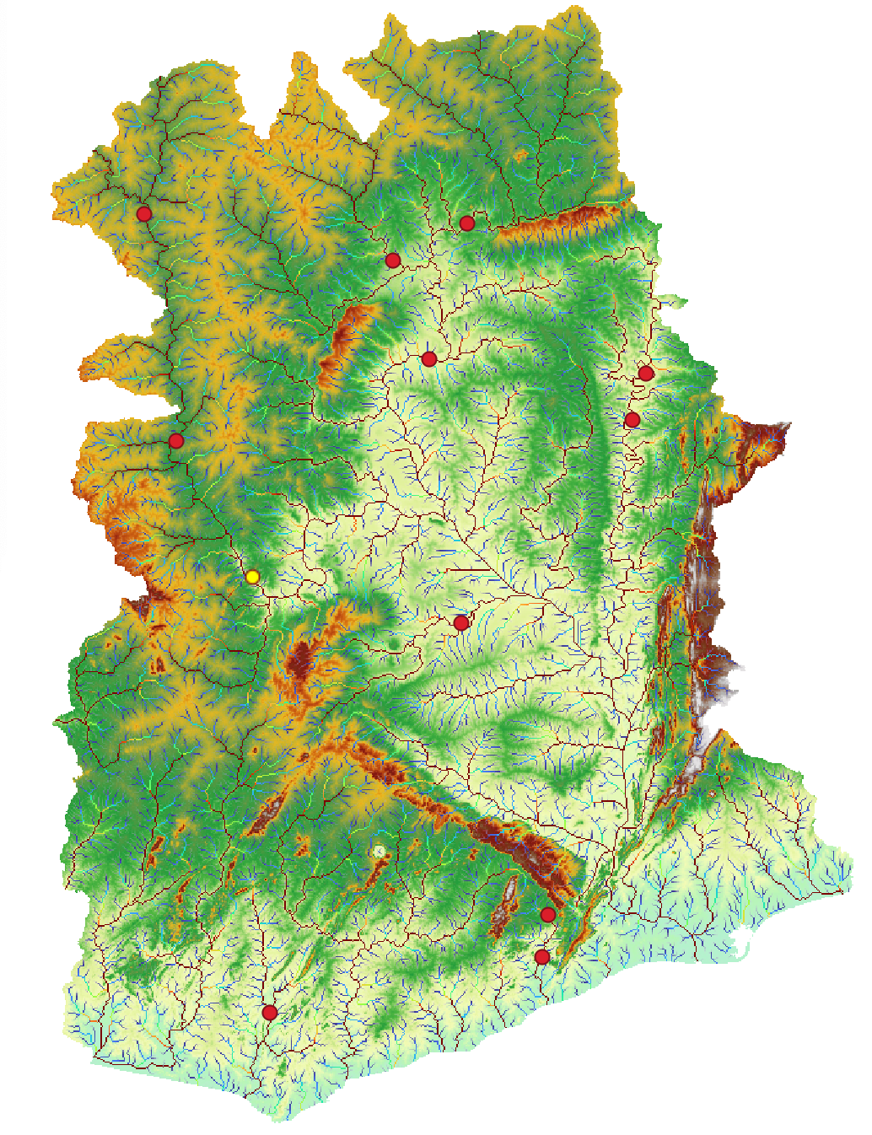
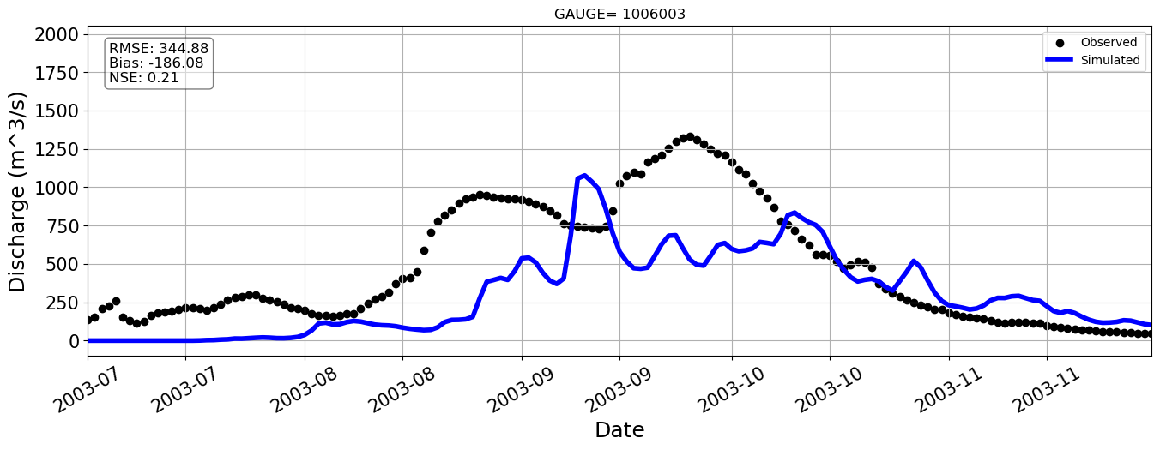
Station=1006003

Slide 11
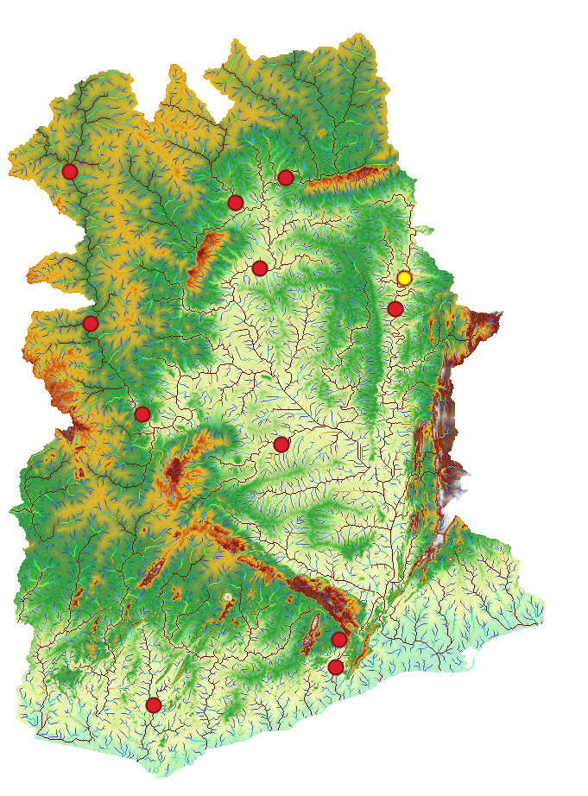
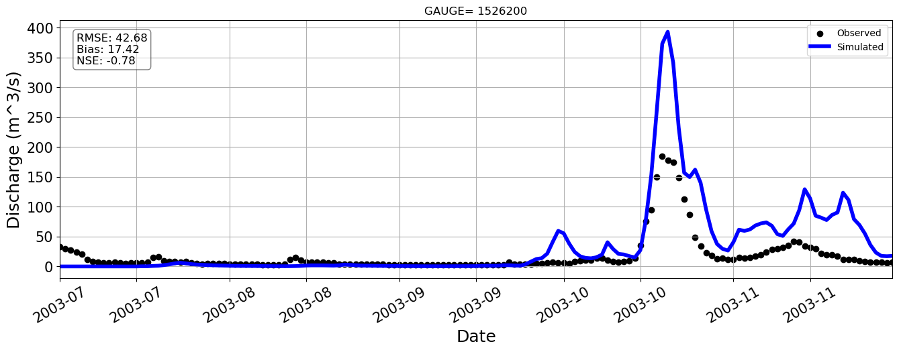
Station=1010002

Slide 12
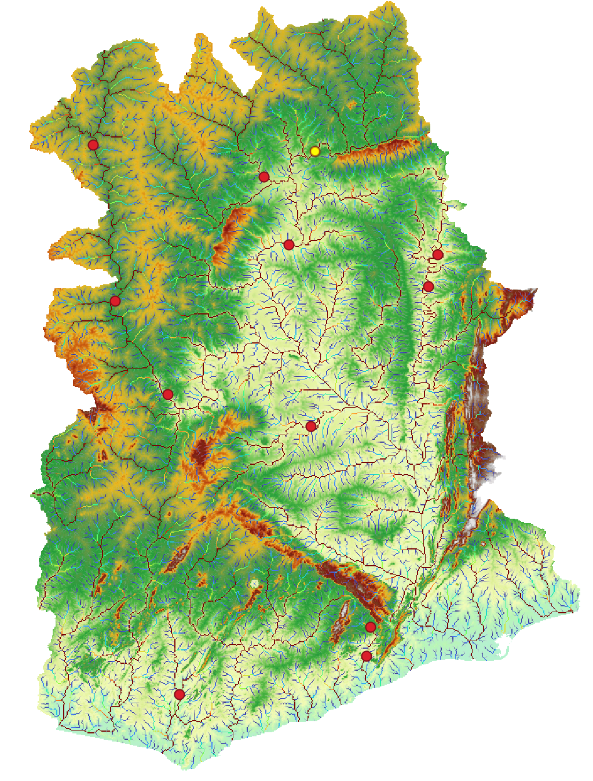
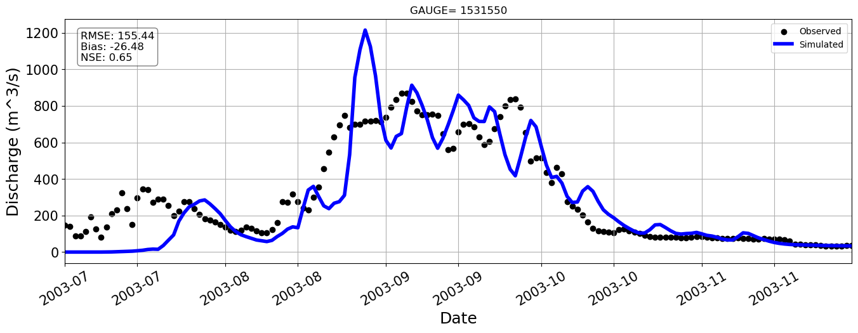
Station=1531550

Slide 13
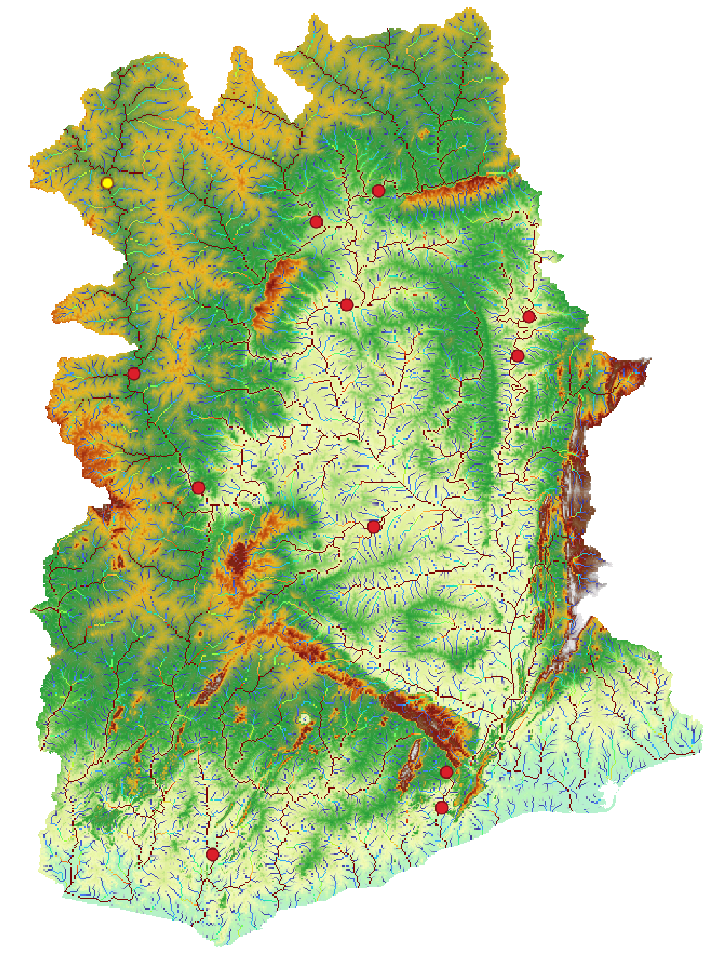
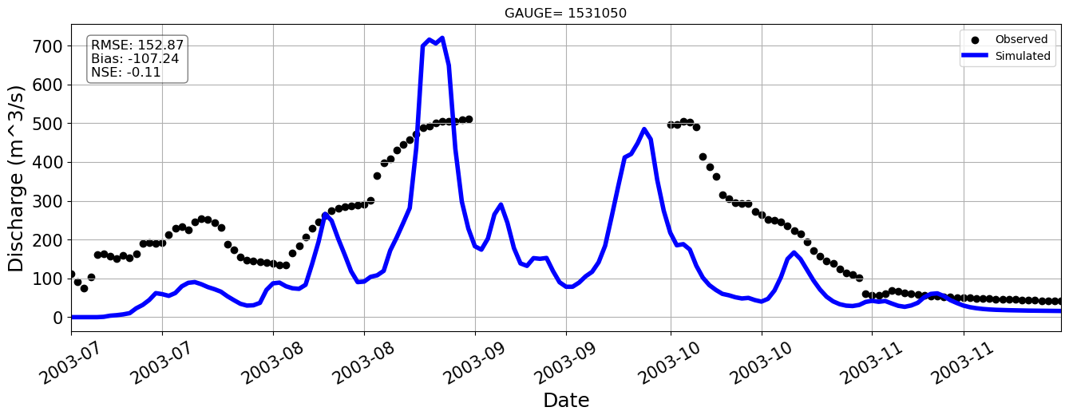
Station=1531050
Notes:
Here for example the model overestimate the observations, but with a negative nash error which is something we don’t want to

Slide 14
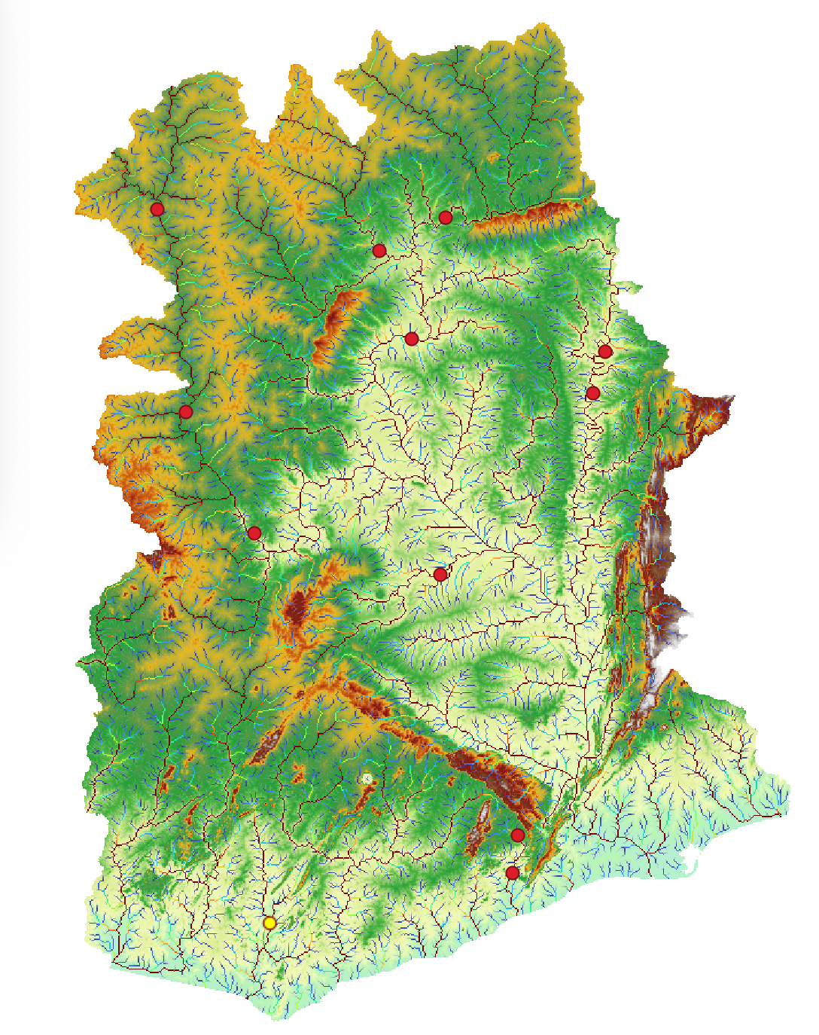
Station=1526200

Slide 15
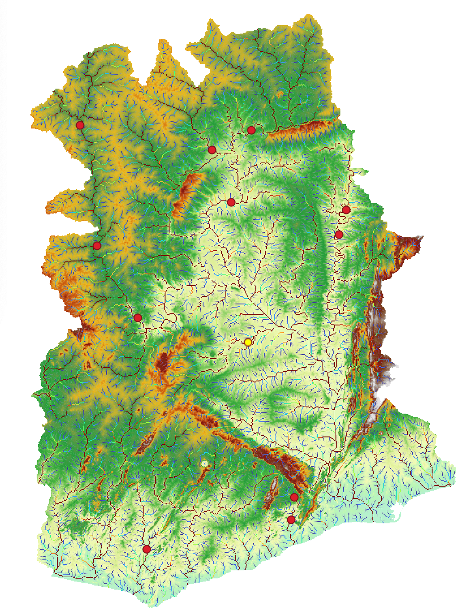
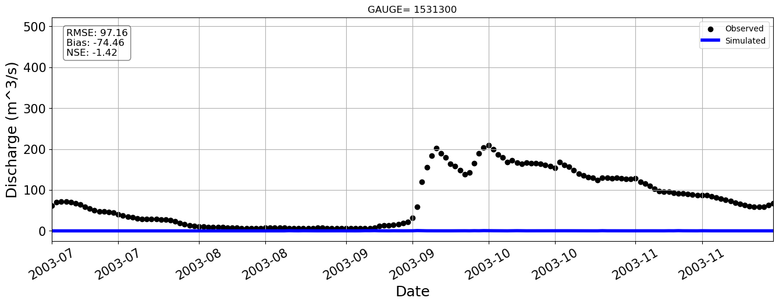
Station=1531300

Slide 16
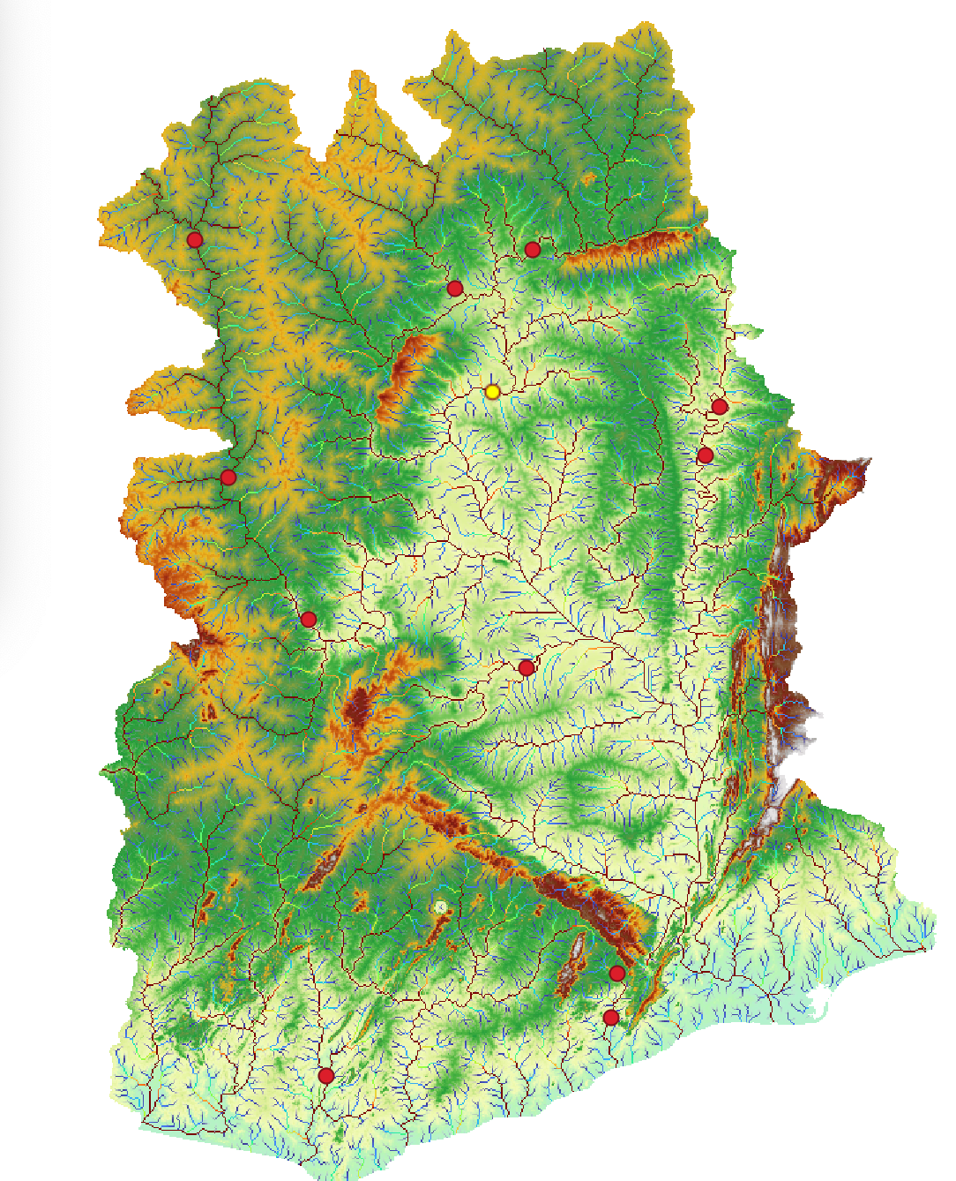
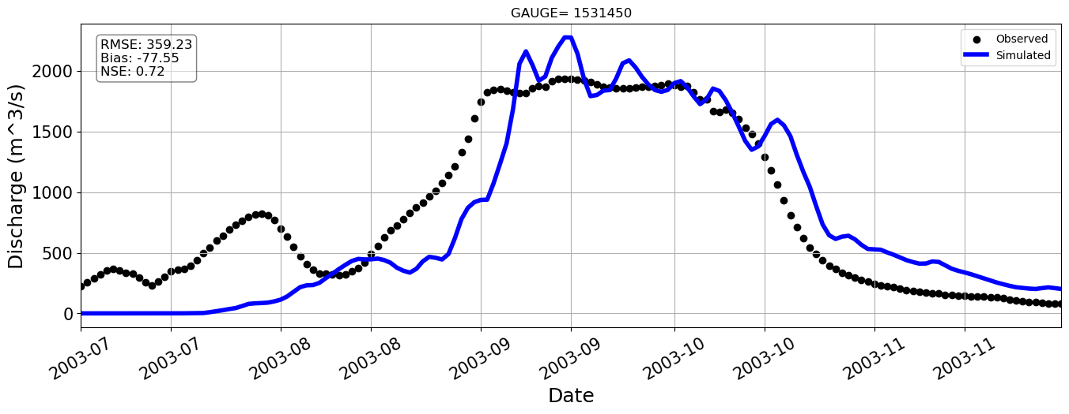
Station=1531450

Slide 17
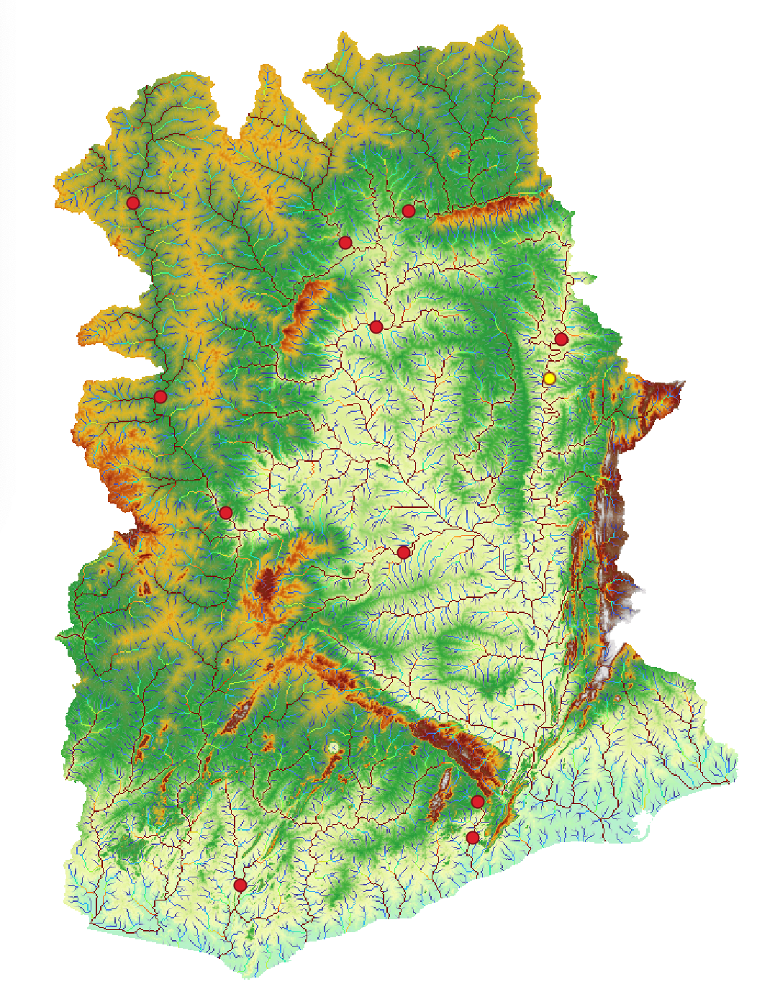
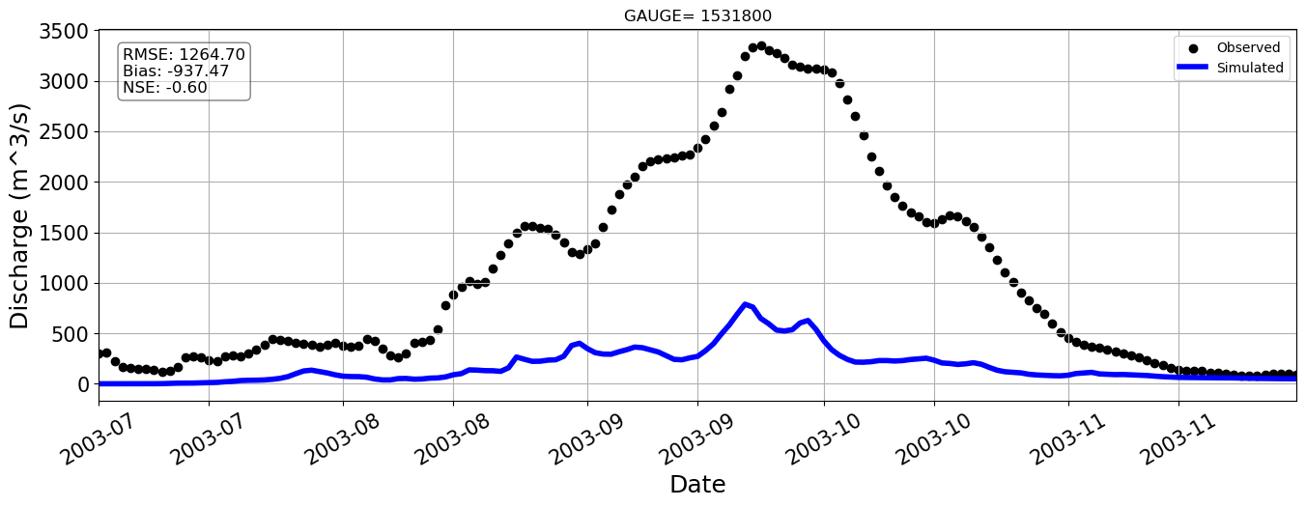
Station=1531800

Slide 18
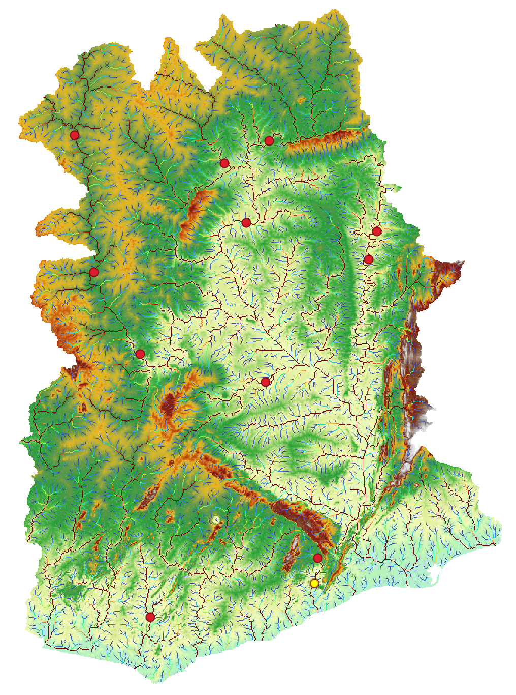
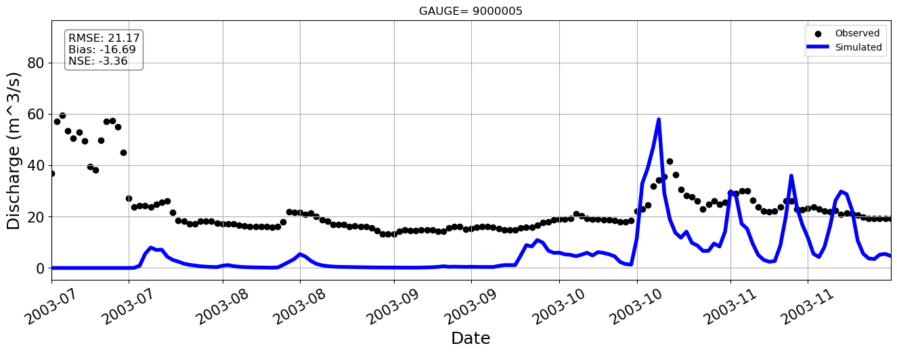
Station=9000005

Slide 19
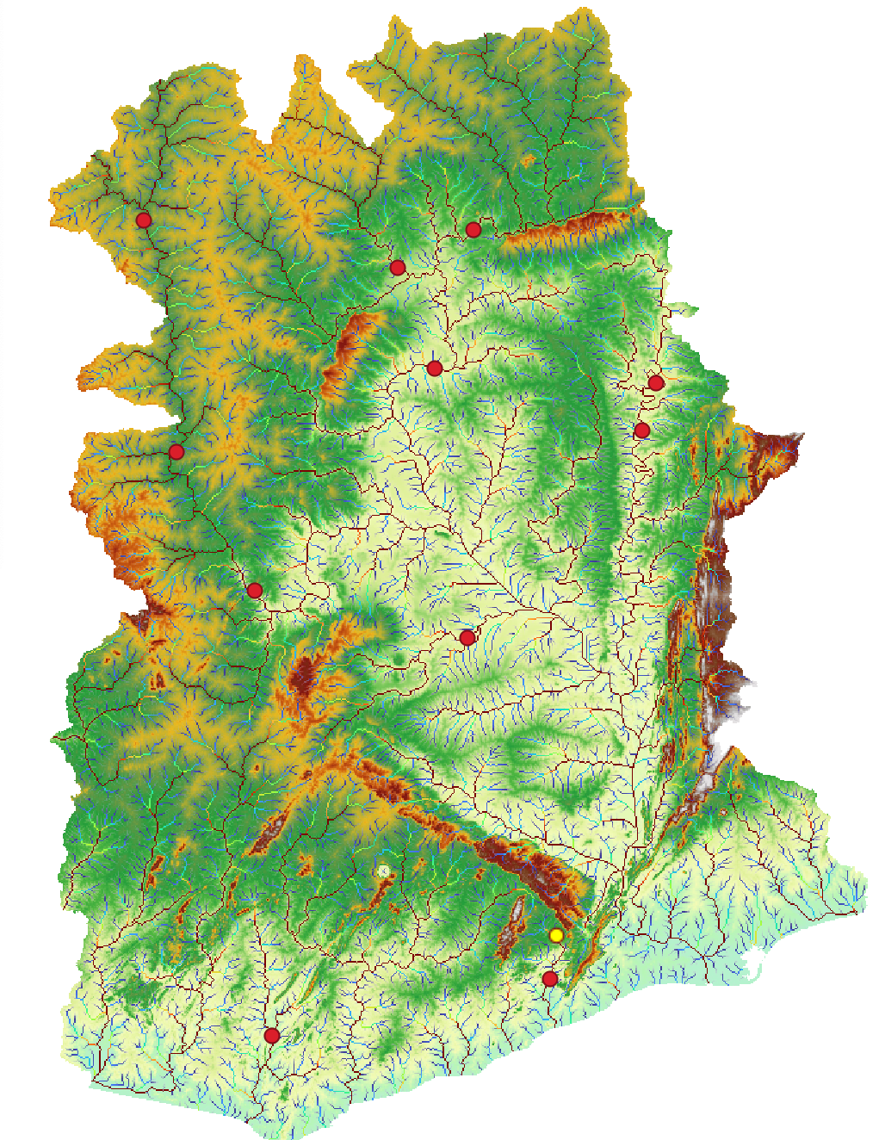
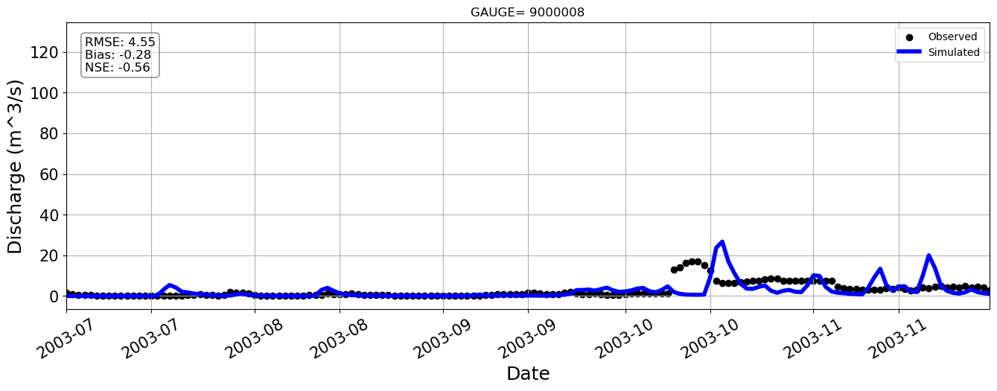
Station=9000008

Slide 20
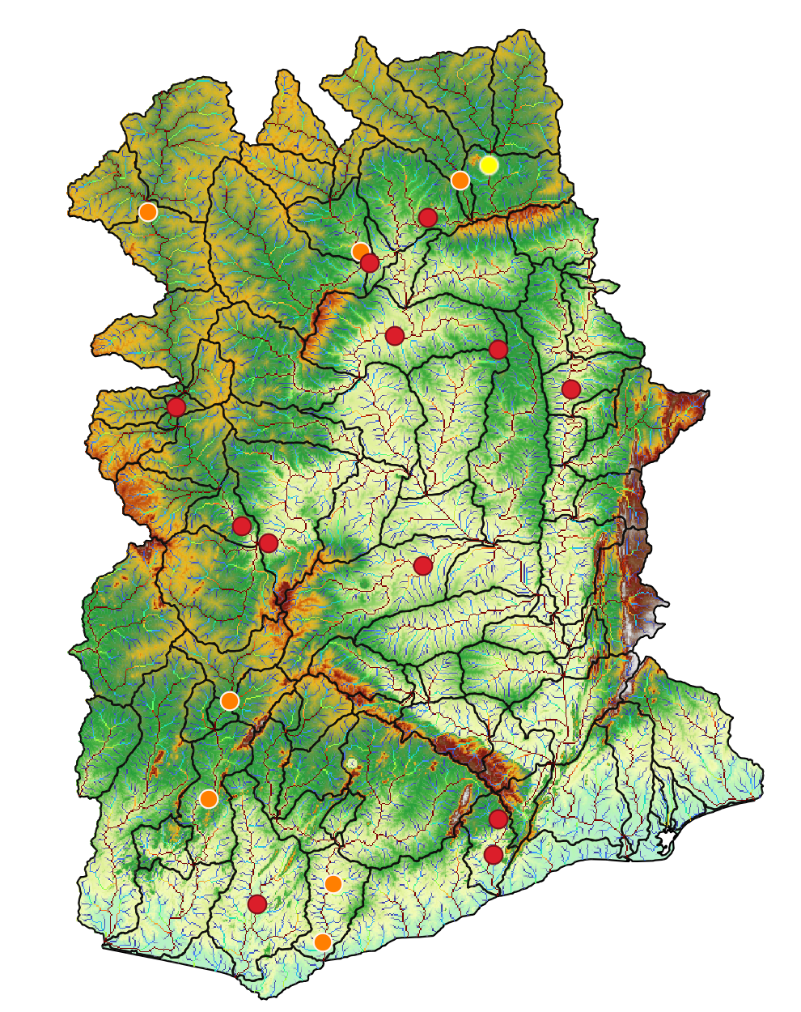
Station=1531600
Notes:
We have some prelimiry results for our ghana baseline. In most of the cases the model overestimate the discharge, however where the model subestimate the observations the NASH error is not so bad. For instance, this two stations..

Slide 21
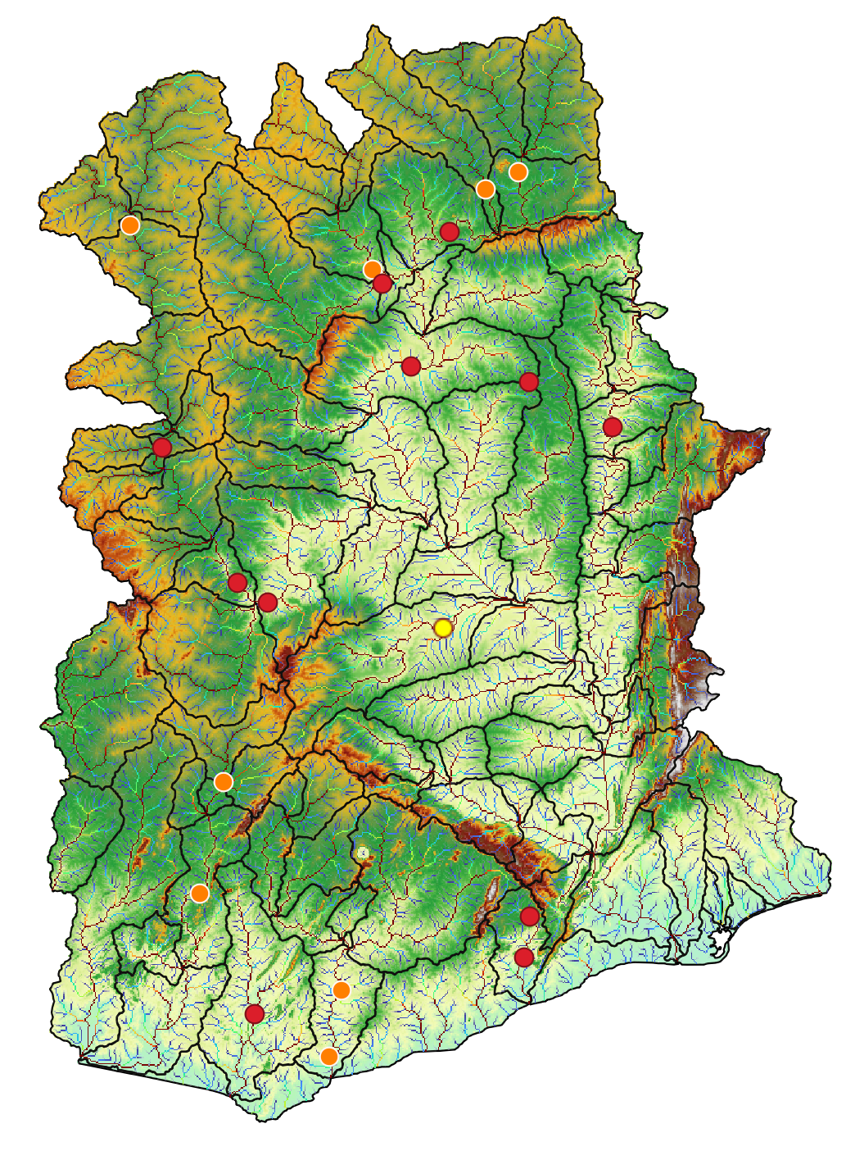
Station=1526300

Slide 22
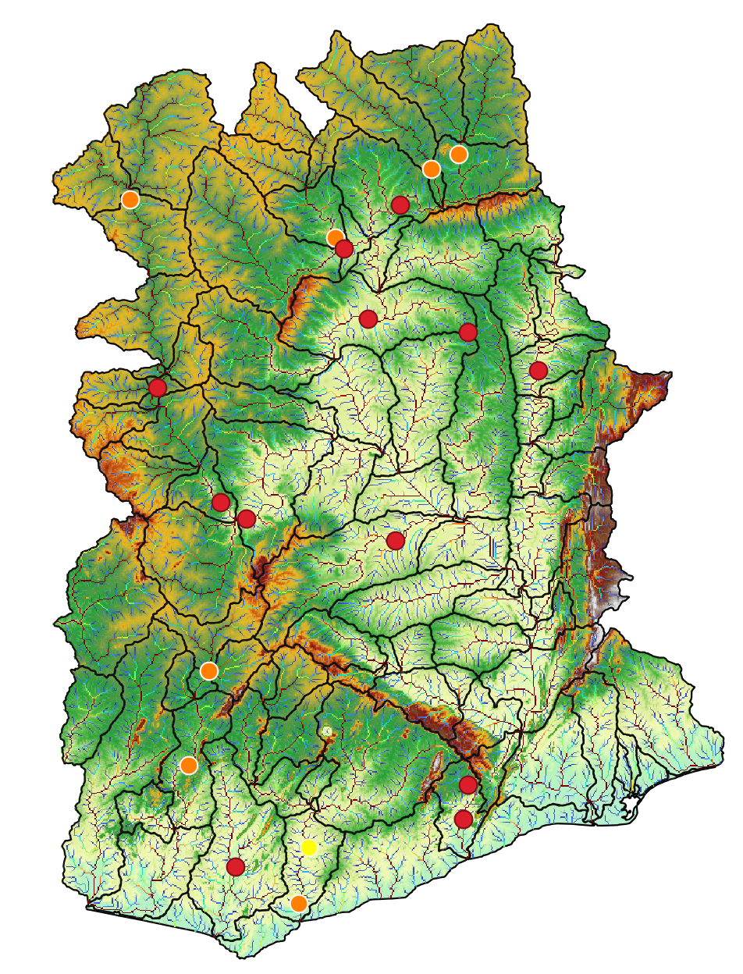
Station=5000001
Notes:
We realize that for some stations we don’t have data from the model, so we need to correct the location of the gauge.
So, this week we are going to correct that locations and run again the model to see if improves

Slide 23
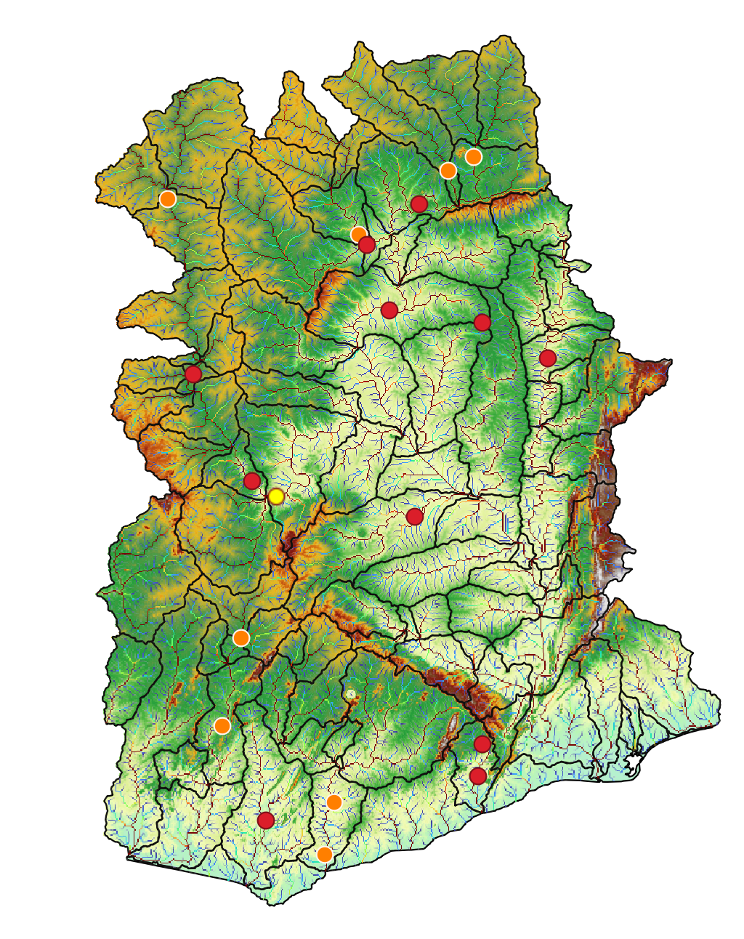
Station=1531100

Slide 24
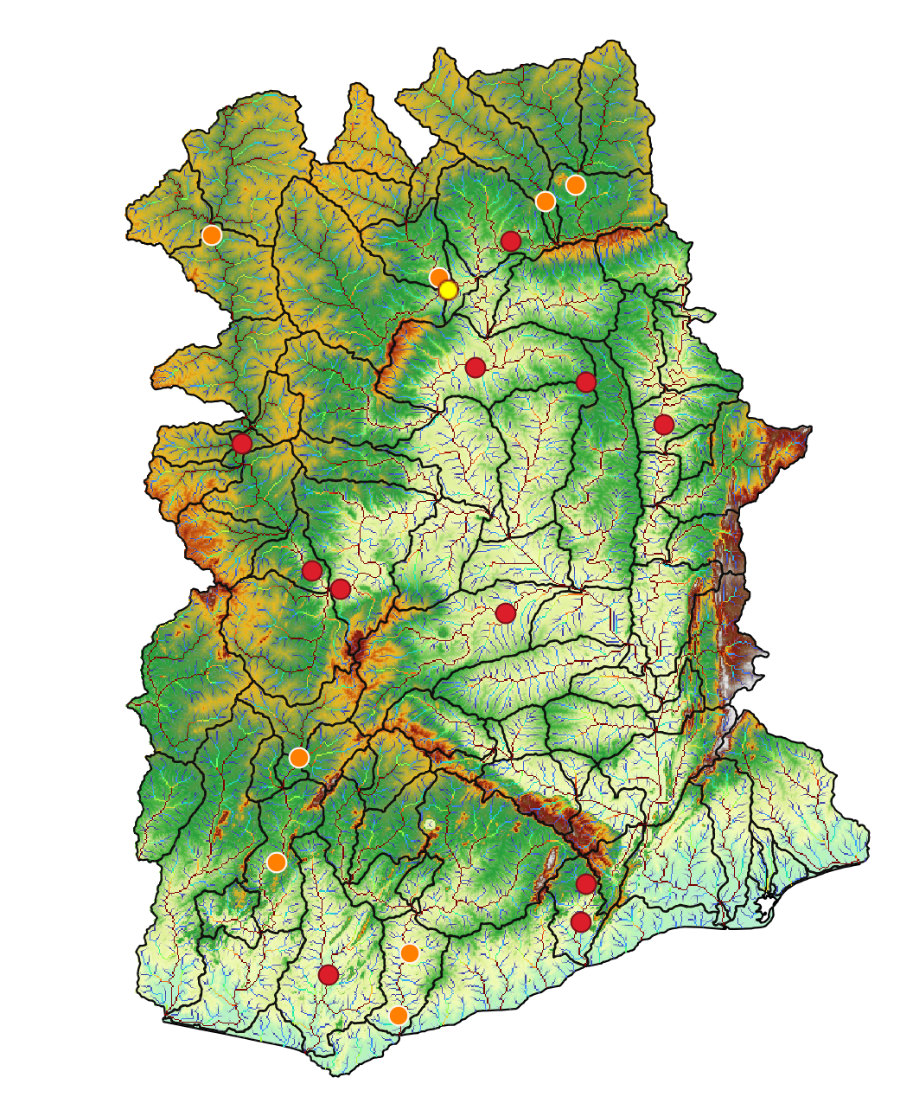
Station=1531420

Slide 25
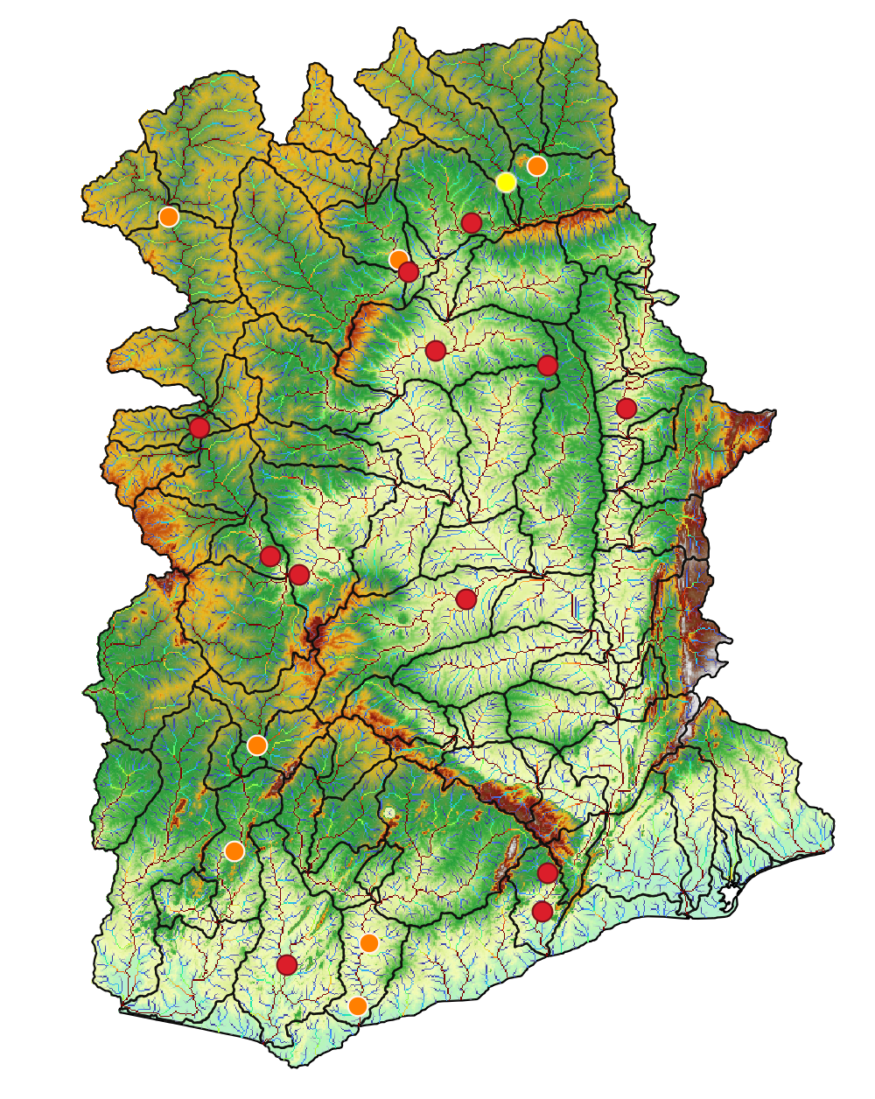
Station=1531650

Slide 26

Station=3000003

Slide 27
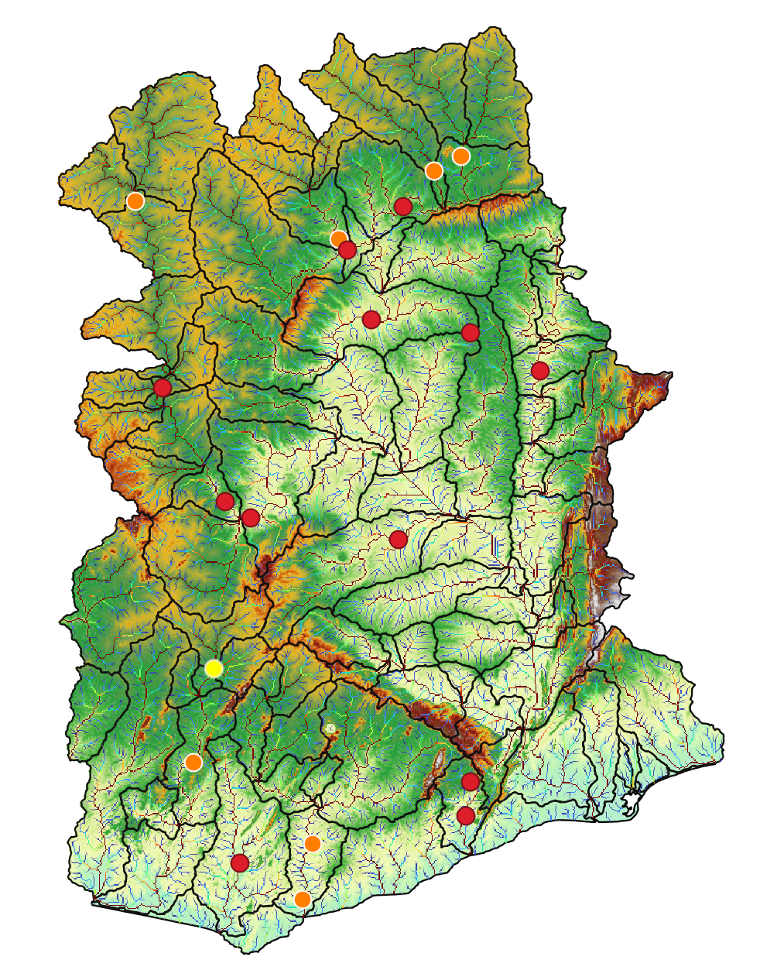
Station=3000004

Slide 28
Baseline 20 years – Ghana 90 m
Baseline 3

Slide 29
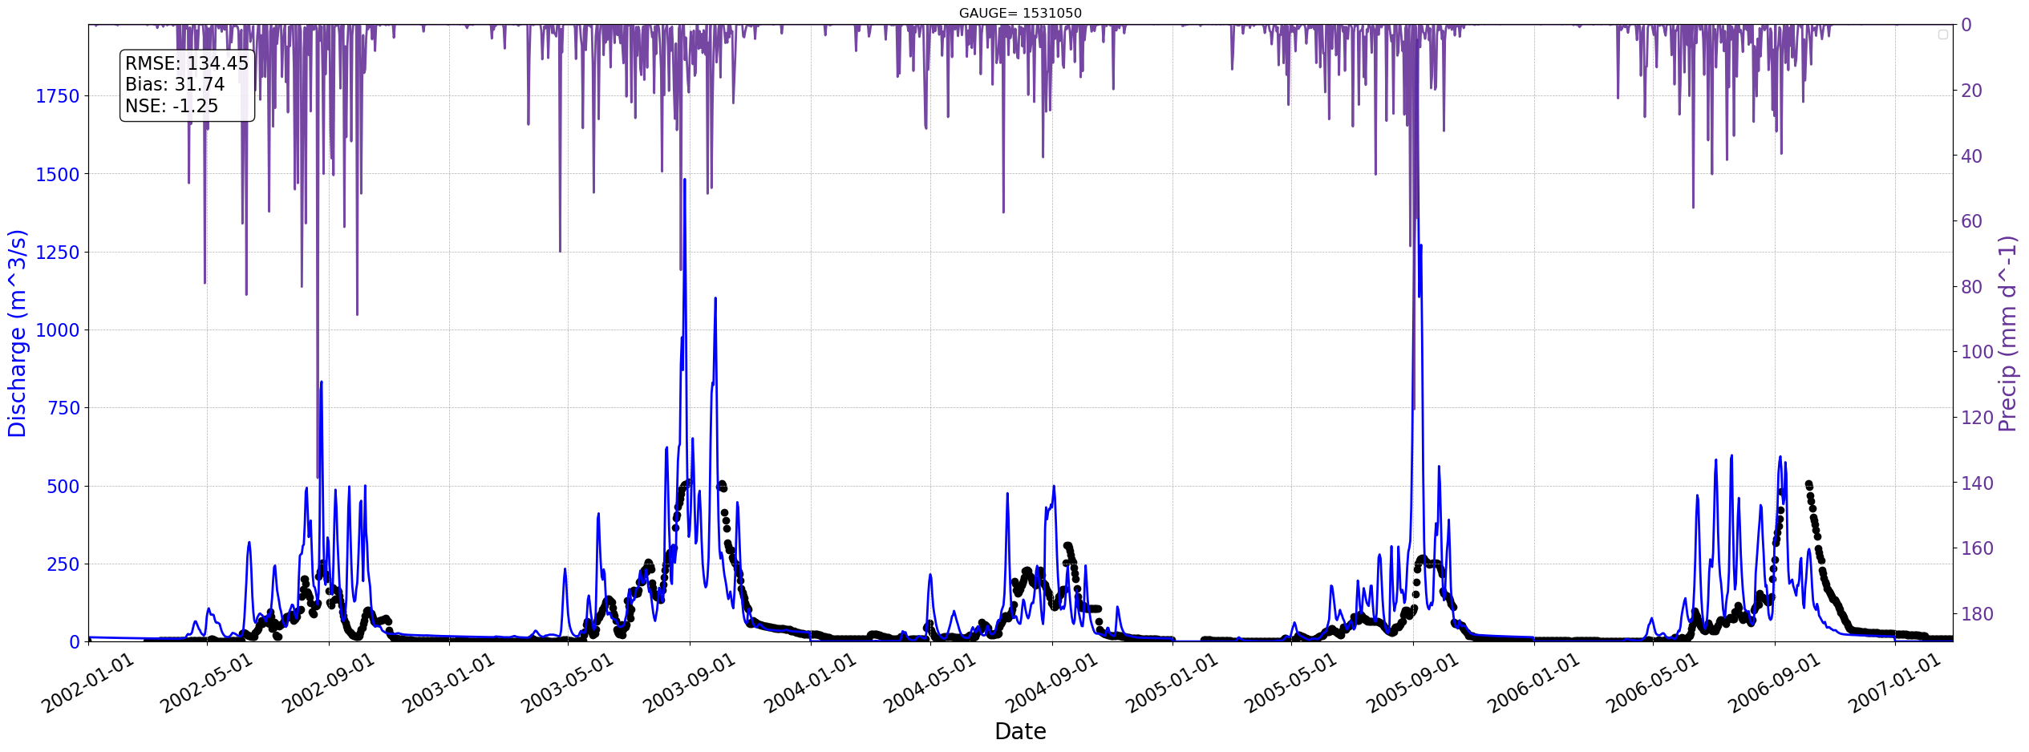
Station=1531050
Notes:
Here for example the model overestimate the observations, but with a negative nash error which is something we don’t want to

Slide 30
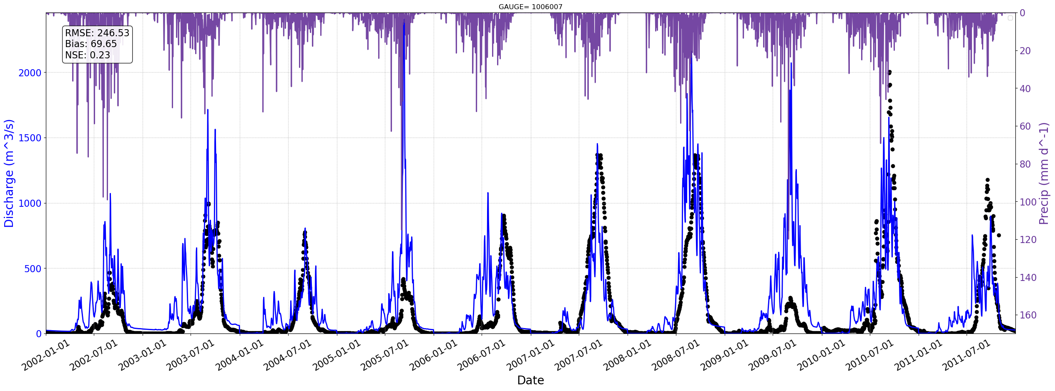
Station=1006007

Slide 31
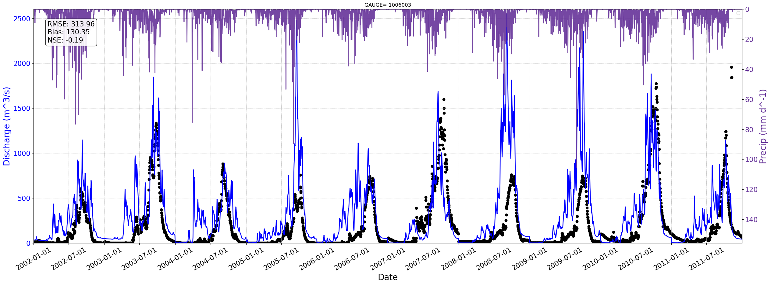
Station=1006003

Slide 32
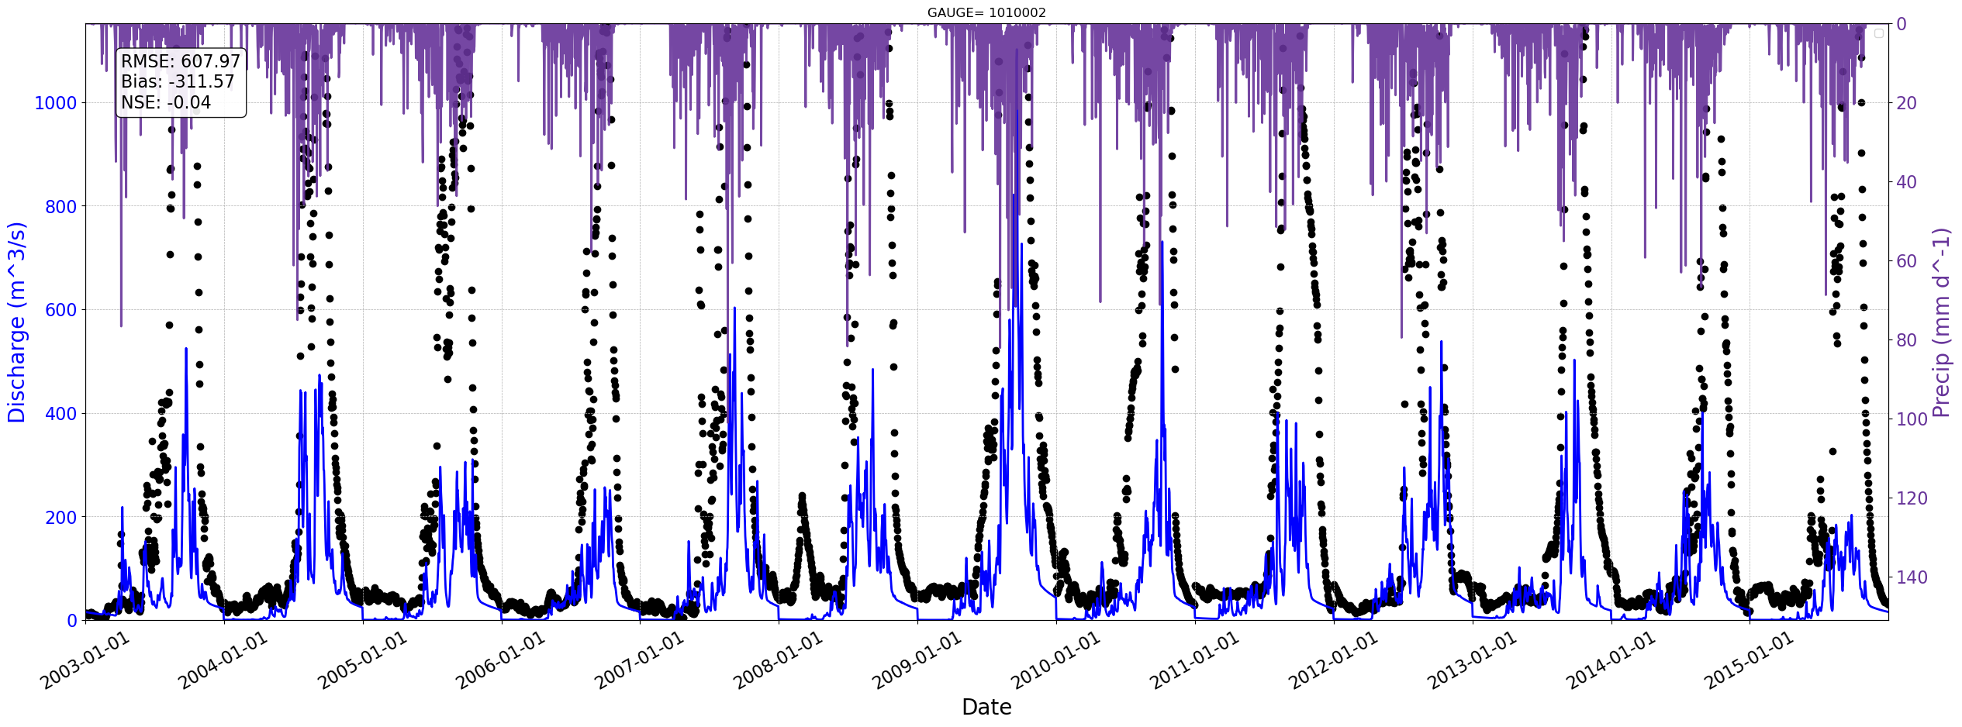
Station=1010002

Slide 33
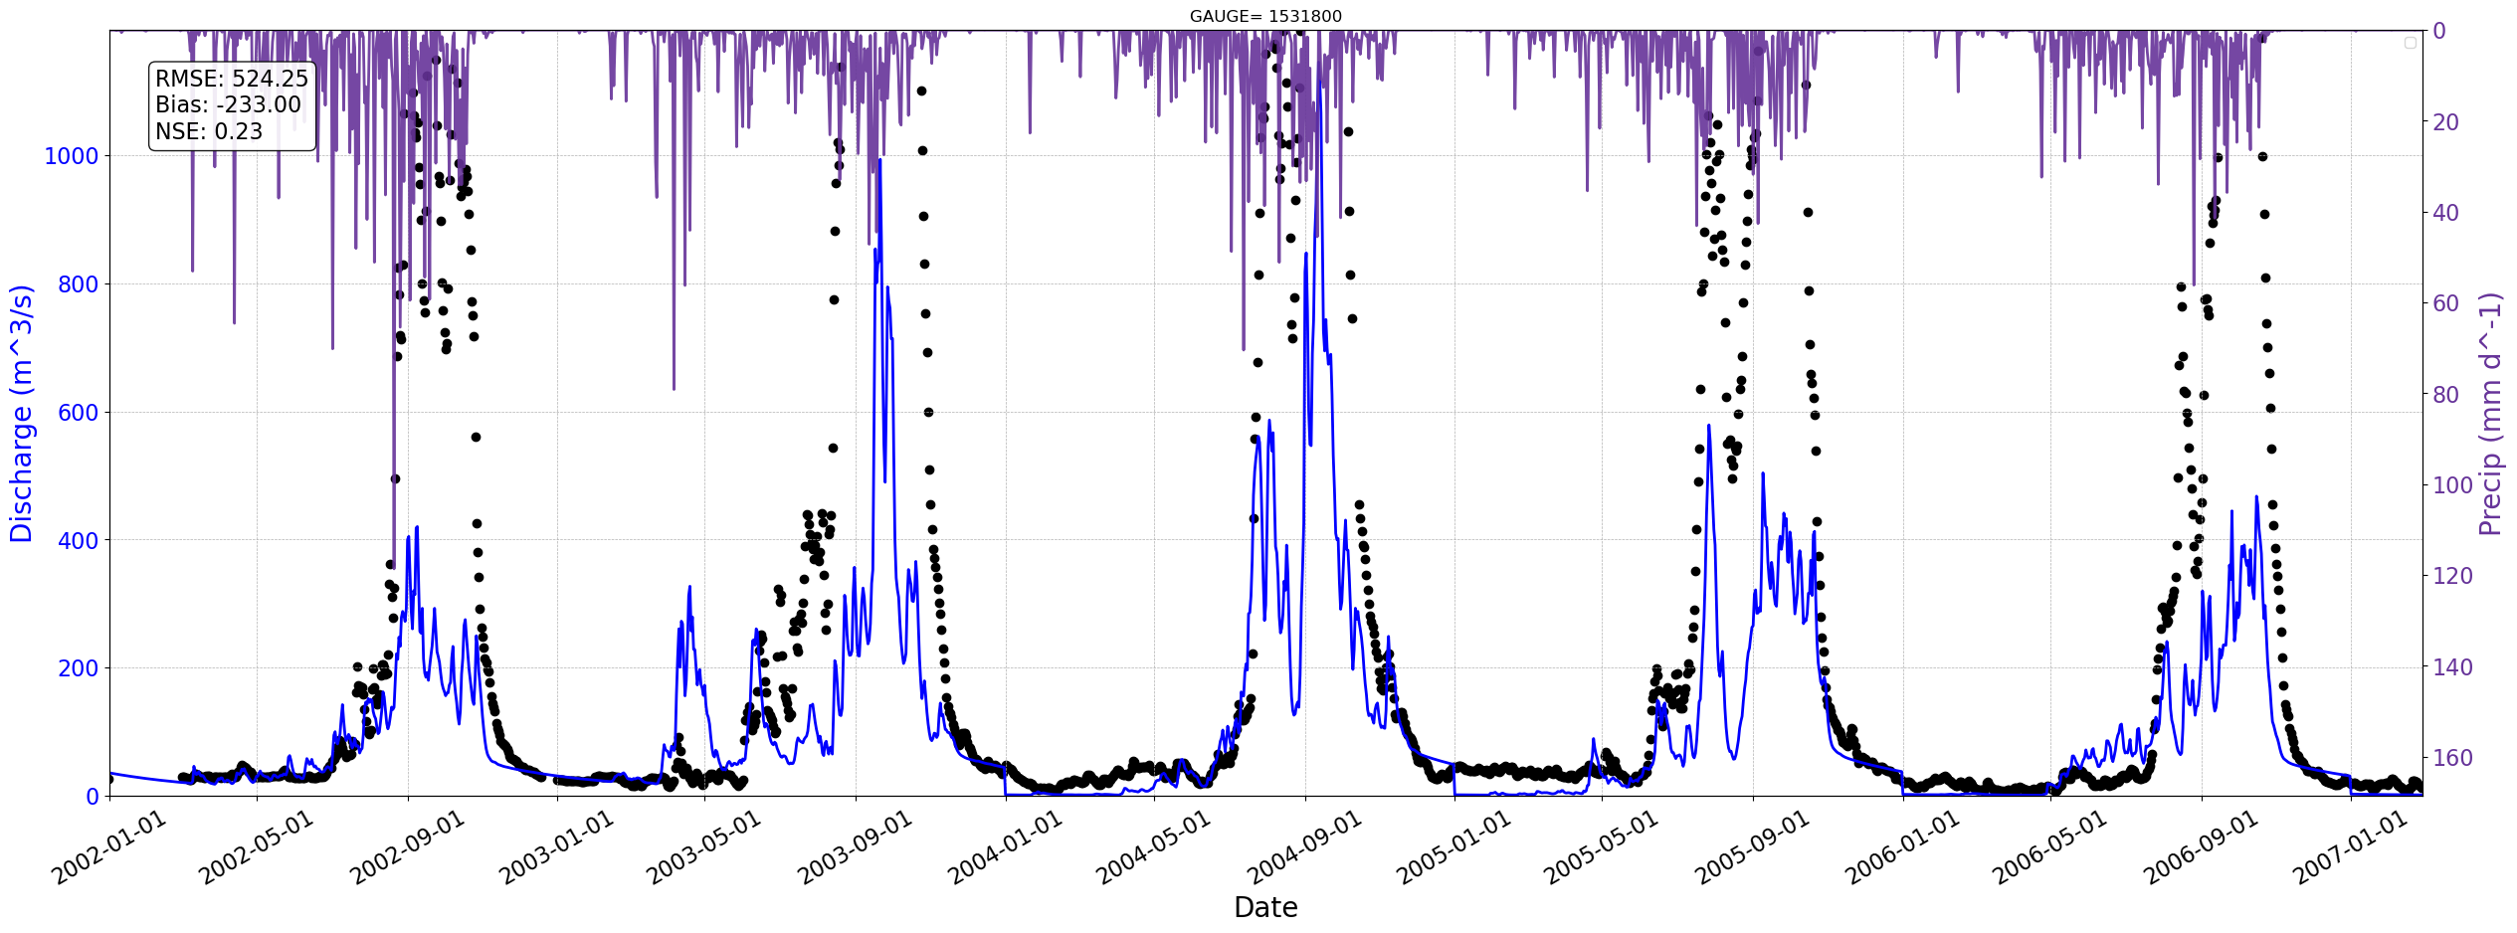
Station=1531800

Slide 34

Station=1531550

Slide 35

Station=1531450

Slide 36

Station=1531300

Slide 37

Station=1526200

Slide 38

Station=9000005

Slide 39

Station=9000008

Slide 40

Notes:
I worked on studying the model and the parameters to understand what might be going on with the results we were getting from the baseline.
Initially we observed that the model generally reproduced the timing of the peaks and responded correctly to precipitation events, but the model overestimate the observations. And that gave us some signals about starting to change some parameters of the crest model.

Slide 41
Seasonal evaluation
Baseline 20 years – Ghana 90
Notes:
I worked on studying the model and the parameters to understand what might be going on with the results we were getting from the baseline.
Initially we observed that the model generally reproduced the timing of the peaks and responded correctly to precipitation events, but the model overestimate the observations. And that gave us some signals about starting to change the parameters of the crest model.
However I wanted to be sure and I wanted to understand what the performance of the model was at the seasonal scale. To see the big picture.

Slide 42


Notes:
"So here we have an example with this station.
At the top, we can see the simulated mean discharge in blue compared to the monthly observations in black. The error metrics are shown in the upper left panel. Overall, the model overestimates the monthly discharge, with a normalized bias of 57%.
We also calculated the monthly anomalies and used Pearson correlation to see if the model is capturing the anomaly signal throughout the year. In the lower right panel, we have a boxplot of the simulated and observed anomalies. For this station, there’s a strong positive correlation of monthly anomalies across all years, which means we’re capturing at least the annual variability. However, in the lower left plot, we see that the model captures more variability and has more outliers."

Slide 43


Notes:
"We also wanted to see which months the model performs best in, so we calculated the error and anomalies from the daily data for each month. As you can see, the model tends to overestimate discharge in August, September, and October.
The correlation of the anomalies shows whether the model can capture the variations that we see in the observations each month. Ideally, we’d like to see strong, positive correlations across all months. However, in this case, the model struggles at the beginning of the year, in July, and in September.
So we want to improve the errors in the complete daily timeseries but also in the seasonal scale.

Slide 44




Notes:
"One thing that caught our attention is that, when we looked at the stations in northern Ghana, we noticed an almost unimodal rainfall pattern, with the basin responding to the rainy months from July to September. Even though the model tends to overestimate the discharge amount, it still manages to capture this seasonal pattern."

Slide 45



Notes:
But when we look at the gauges in the southern region, The regime in the precip changes.. And it seems more like a bimodal regime with two peaks, one in April-march and the other one in sep-oct
With less precip in the middle of the year and in the end and beginning of the year.
We can see the model responding to this bimodal pattern, simulating a similar double-peak response. However, when we compare it to the observations, the peaks in the model appear slightly out of sync with the actual precipitation events.
We’re thinking there might be some infrastructure in these areas that’s slightly delaying the hydrologic response of these basins.

Slide 46
Next steps:
Run again but changing PET.
Test TITO on AGRYMET hpc
Notes:
because we believe that the potential evapotranspiration layers we are using are underestimating the evapotranspiration especially in the summer months... So we adjusted these layers and the next step is to run the model with these new pet layers.
On the other side, I met with Akshay and I test TITO by myself.. There were some things that needed to be corrected, I think Akshay already did the corrections so after this meeting I could test again.

